Slide 1
medical simulation
Dr Anna Jenczura
Instytut Nauk o Zdrowiu/ Institute of Health Sciences
Uniwersytet Opolski/ University of Opole

Slide 2
What is symulation?
THE MEDICAL SIMULATION CENTER is a facility that is equipped with advanced technologies - patient simulators

Slide 3
what is simulation?
medical simulation is the most dynamically developing branch of medical education
simulation is a tool that uses new technology: simple trainers and complex advanced mannequins

Slide 4

Watchword:
„Where others faint, we begin to live”

Slide 5
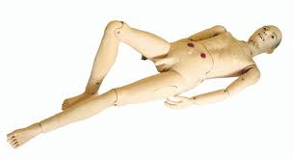
we have many nursing simulators in the simulation center man

Slide 6
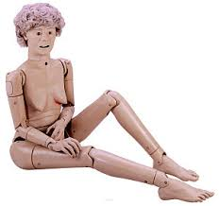
woman

Slide 7
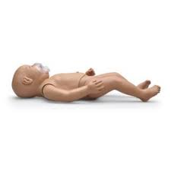
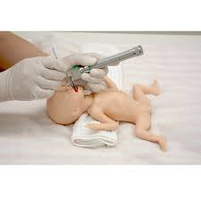
Child, Baby

Slide 8
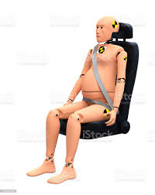
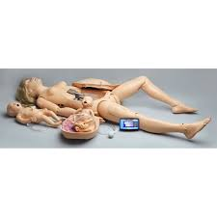
we have many obstertics simulators in the simulation center pregnant woman

Slide 9
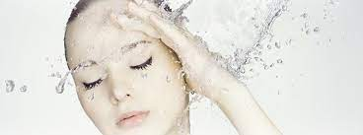
Human manekin…
is sweating

Slide 10
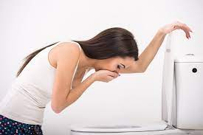
Human manekin…
vomits

Slide 11

Human manekin…
talks
screams
answers questions

Slide 12
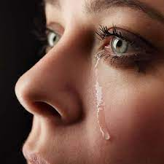
Human manekin…
cries

Slide 13
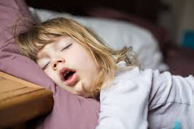
Human manekin…
breathes - does not breathe

Slide 14
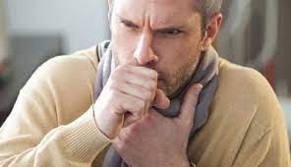
Human manekin…
coughs
is choking, choking

Slide 15
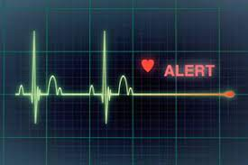
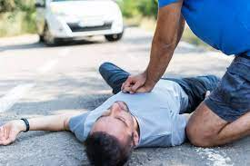
Human mankin… cardiac arrest ASYSTOLE!!! stopping breathing

Slide 16
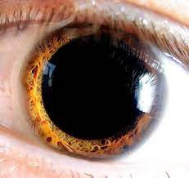
Human manekin…
has large or small pupils

Slide 17
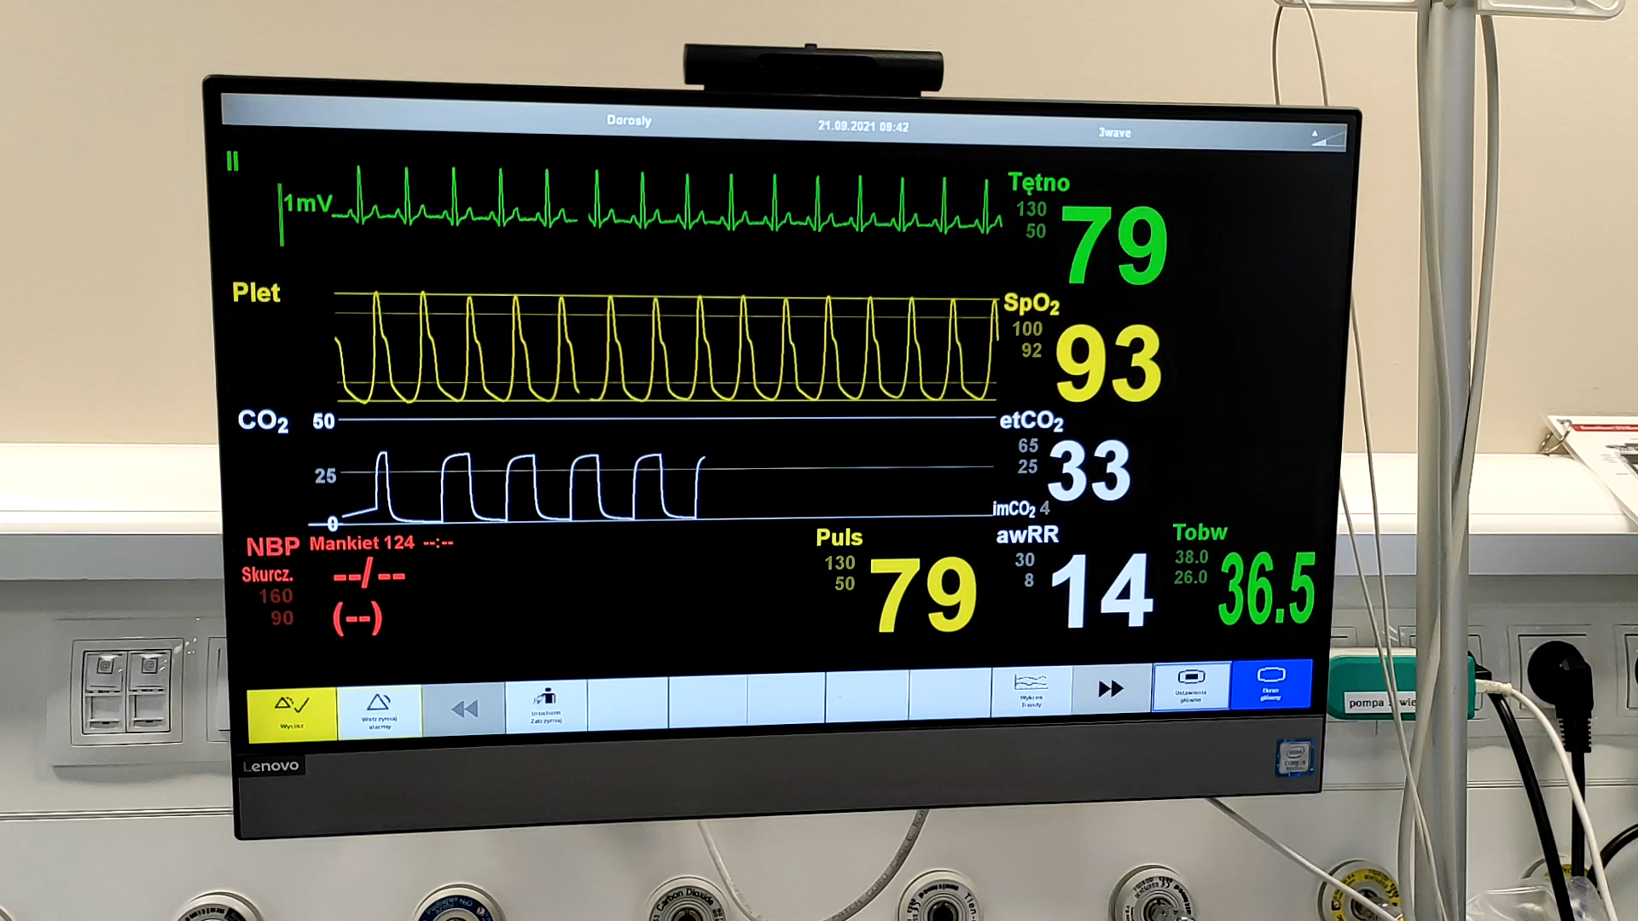
we have full monitoring of the patient's vital signs
WE MONITOR:
pulse
pressure
saturation
the work of the heart
temperature
breaths

Slide 18
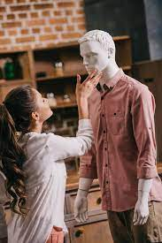
what can a student do?
conduct a medical interview

Slide 19
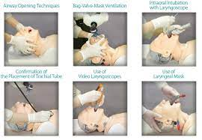
what can a student do?
perform all medical procedures:
  INTUBATION,
  parenteral feeding,
  give medications and fluids
  do injections,
  conduct heart massage

Slide 20
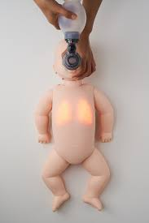
what can a student do?
the student learns cardiopulmonary resuscitation in a newborn

Slide 21
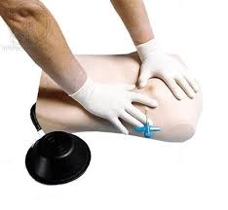
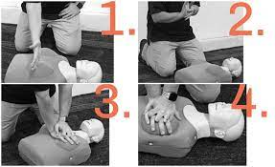
conduct heart massage do injections

Slide 22
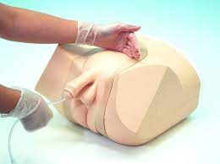
what can a student do?
urinary bladder catheterization

Slide 23
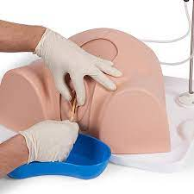
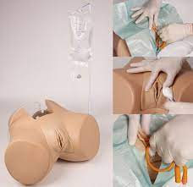

Slide 24
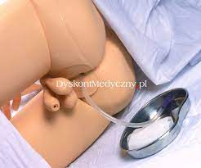
what can a student do?
enema

Slide 25
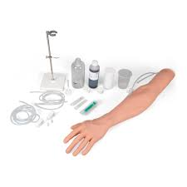
what can a student do?
blood sampling,
insertion of cannulas

Slide 26
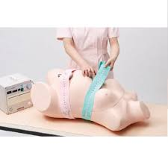
what can a student do?
fetal heart monitoring

Slide 27
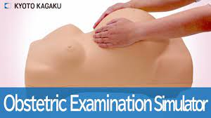
what can a student do?
fetal examination – „Leopold grips”

Slide 28
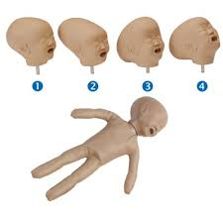
what can a student do?
examination of the fetal head

Slide 29
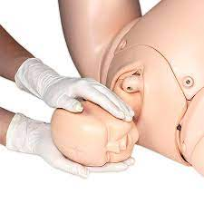
obstetrics
we have a very professional:
obstetric phantoms

Slide 30
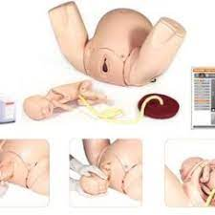
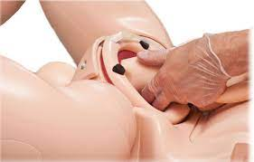

Slide 31
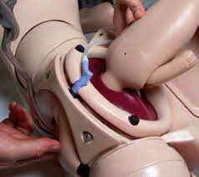
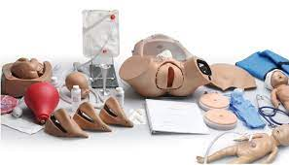

Slide 32
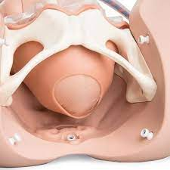
what can a student do?
can learn to assess the obstetric situation

Slide 33
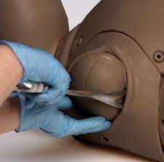
what can a student do?
forceps delivery,
vacum extractor

Slide 34
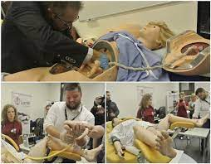
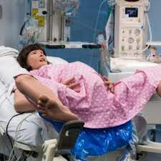
giving birth

Slide 35
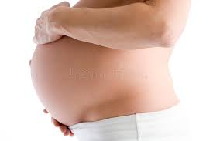
we have hybrid phantoms
- belly phantom

Slide 36
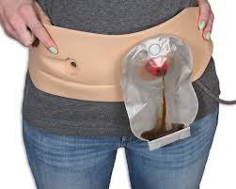
we have hybrid phantoms
ostomy trainer

Slide 37
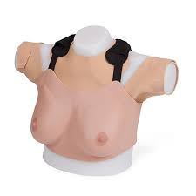
Hybrid phantoms
breast trainer

Slide 38
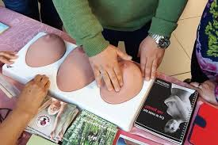
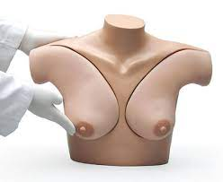
various other phantoms and trainers

Slide 39
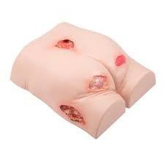
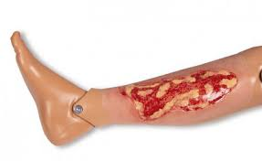
bedsores, wounds

Slide 40

what does our medical simulation center look like?

Slide 41
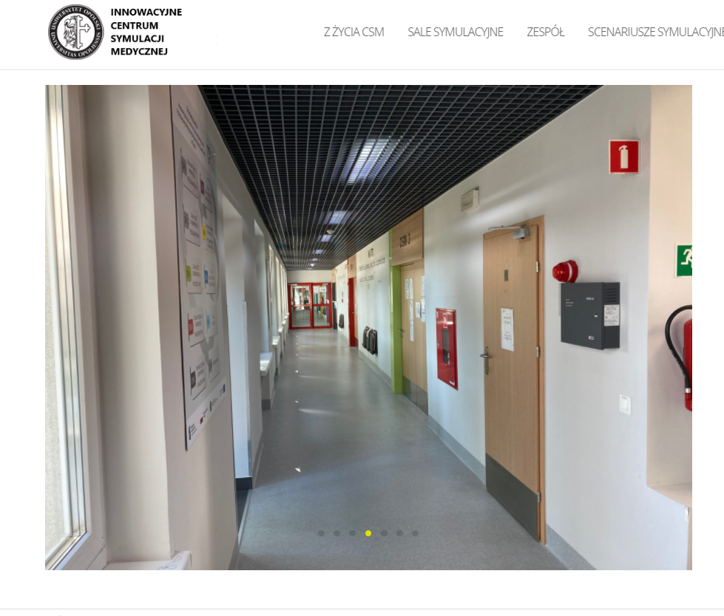

Slide 42
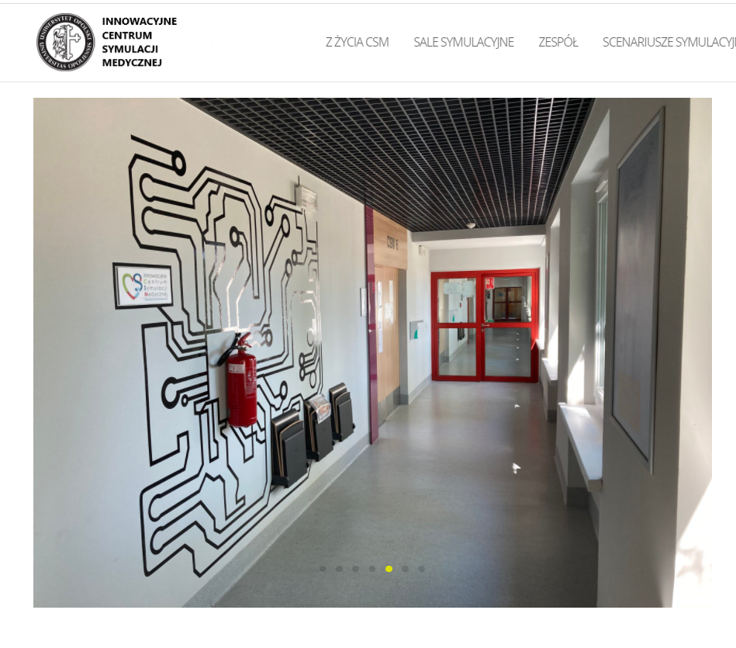

Slide 43
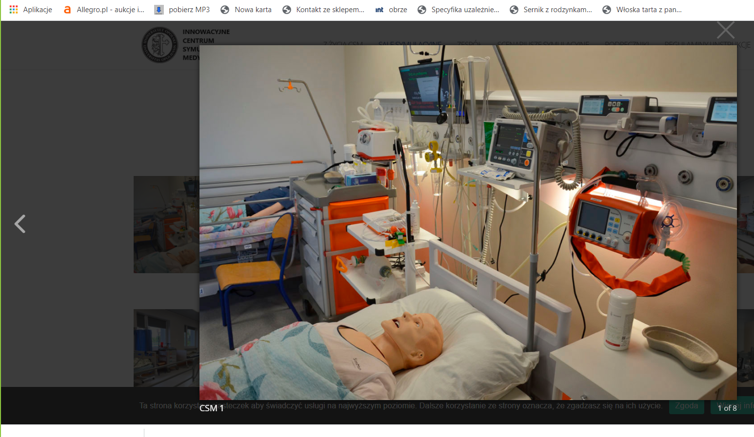
intensive supervision room - nursing

Slide 44
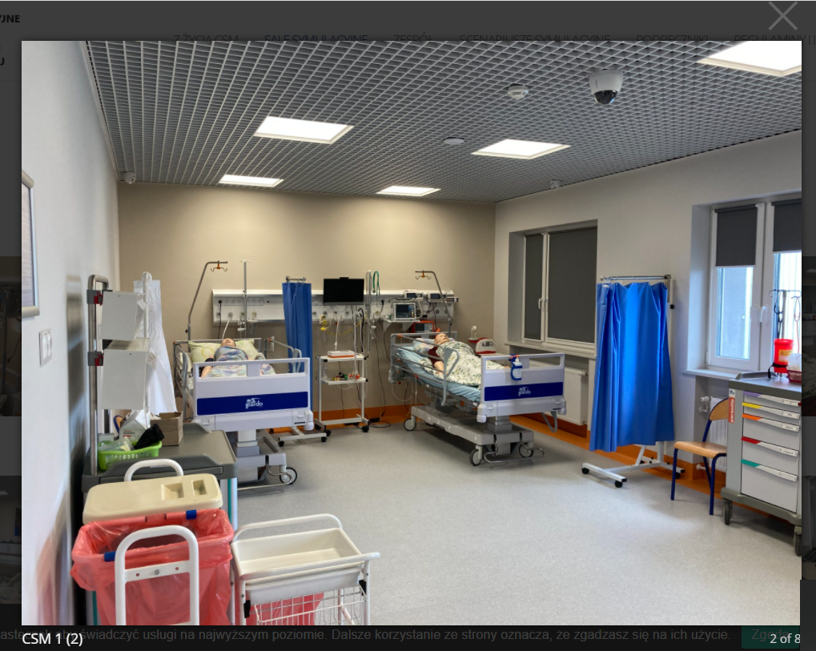
Intensive nursing supervision room

Slide 45
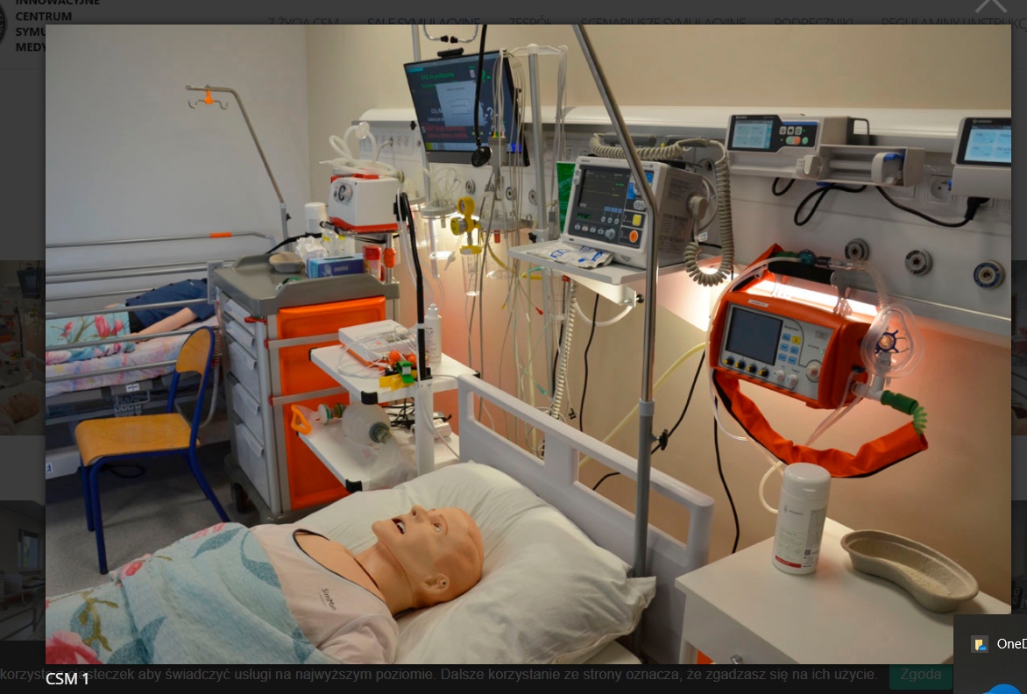
all medical devices are real!

Slide 46
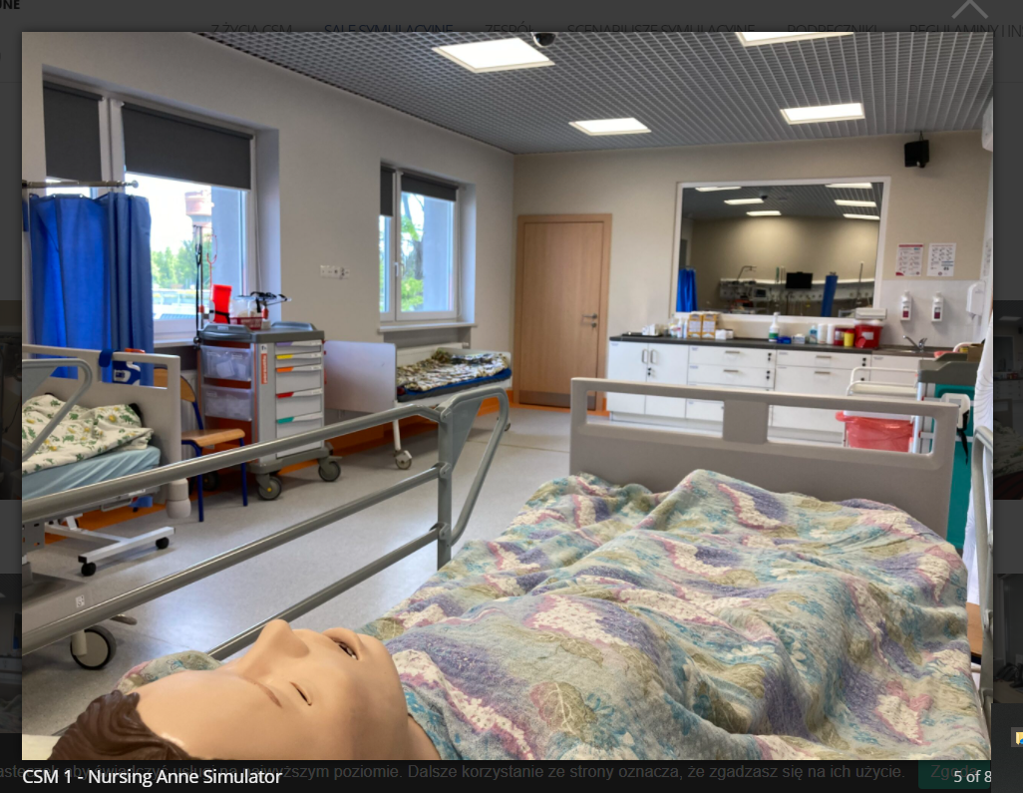

Slide 47


Slide 48

Venetian mirror - the workplace of simulation technicians

Slide 49

simulation technicians room - view of the room

Slide 50

1. simulation technicians workstation

Slide 51

debriefing room
we are watching a simulation movie in this room (here is a TV set)
discuss problems,
feelings,
emotions,
we find solutions to the situation

Slide 52

Debriefing room
debriefing is a necessary element of any simulation

Slide 53

Debriefing room

Slide 54

Debriefing room

Slide 55

Debriefing room

Slide 56

intensive maternity supervision room, delivery room, neonatal corner

Slide 57

all devices are real and really work!

Slide 58

2. Venetian mirror - simulation technicians work room

Slide 59


Slide 60


Slide 61


Slide 62

Control room

Slide 63

neonatal intensive supervision room - caring for premature babies

Slide 64

maternity room and gynecology room

Slide 65

obstetric phantoms

Slide 66

nursing care room

Slide 67


Slide 68


Slide 69

nursing supervision room

Slide 70


Slide 71

home care room

Slide 72

medical simulation textbooks: nursing & obstetrics

Slide 73
who has classes at the simulation center?
Nursing
Obstetrics
:) about 20% of all exercises in a specific subject
We want more!

Slide 74
working rules in the simulation center
EACH EDUCATOR/TEACHER MAKES A SIMULATION SCENARIO !!!!
THE SCENARIO CONTAINS A LOT OF INFORMATION
Information for the student is: who is the patient (age, sex), what symptoms the patient has
Information for the simulation technician is: how the patient is to be dressed, what are the values ​​of vital parameters,
what will happen in a few minutes (e.g. hemorrhage, shock, asystole, fainting)

Slide 75
working rules in the simulation center
Medical technicians make movies.
Each video is played and all students (the whole group) observe the students' activities.
Later it's time for debriefing………………………………………………………..

Slide 76
Debriefing time
what did you feel?
were you scared?
did you feel stress?
what are your conclusions?
what were the difficulties?

Slide 77
Debriefing time
PURPOSE OF DEBRIEFING:
the student independently finds gaps in knowledge and skills.
* He does it himself (I suggest ONLY)

Slide 78
principles of teachers' work in the simulation center
you must not use the phrases:
you don’t know,
you have gaps in knowledge,
you have gaps in skills,
how can you not know it yet ?!
NO CRITICISM !!!!!!
HERE EVERYONE MAKES MISTAKES

Slide 79
rating
the student has a credit for the course on the basis of attendance!
WE NEVER RATE!

Slide 80
what feelings do students feel?
OFTEN:
big stress
many strong emotions
panic
want to run away
laughter attack - the result of stress

Slide 81
often classes at the simulation center are very difficult for students
THE TEACHER MUST BE VERY CAREFUL NOT TO ALIENATE THE STUDENT.
Therefore, every medical simulation teacher has to complete a complicated six-month course.

Slide 82

simulation scenario

Slide 83


Slide 84


Slide 85


Slide 86


Slide 87


Slide 88


Slide 89


Slide 90


Slide 91


Slide 92
Debriefing time!!!
What did you feel?.......

Slide 93
multiculturalism
We have an international Erasmus project on multiculturalism.
I want to show you what it is like to work in a simulation center
These are just rehearsals for the project!!!

Slide 94
blind
street childbirth

Slide 95
hinduism
lotus birth

Slide 96
islam
severe postpartum hemorrhage

Slide 97
follow-up plan of our meeting
1. lunch at 12:00
2. meeting in the simulation center:
- sightseeing, viewing mannequins and trainers
- trying to play a script

